Slide 1
Uncovering the Face of Android Ransomware:
Characterization and Real-Time Detection
2018 TIFS

Slide 2
Challenges
Lack of Android ransomware dataset
Infeasible of transplanting PC solutions
directly

Slide 3
Insights
Collecting real-world dataset
(2,721 samples from 15 families)
Implement a real-time UI-based detection system(RansomProber)

Slide 4
Ransomware
Locker
Encrypter

Slide 5
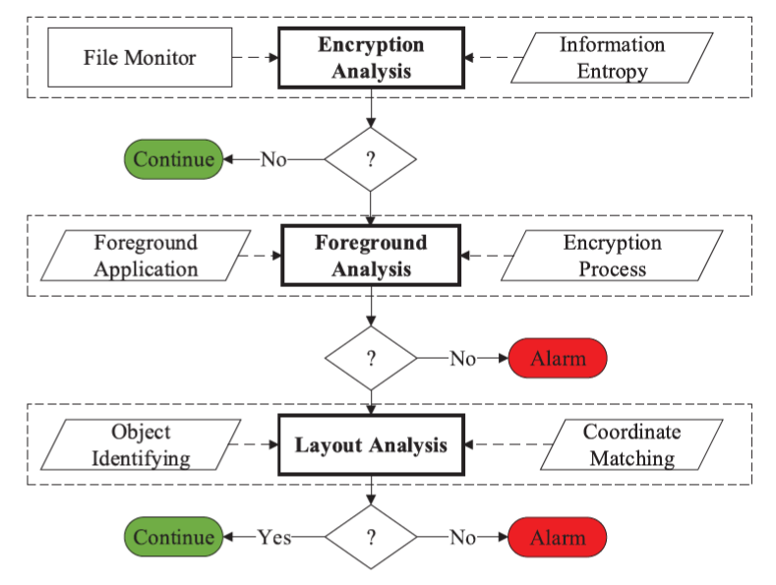

Slide 6
File Monitor
/Android/data
/data/system/accounts.db
/data/… /contacts2.db
/data/… /mmssms.db
/sdcard/Pictures
/sdcard/Downloads

Slide 8

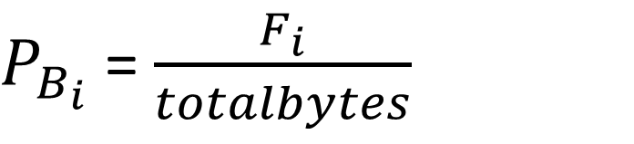
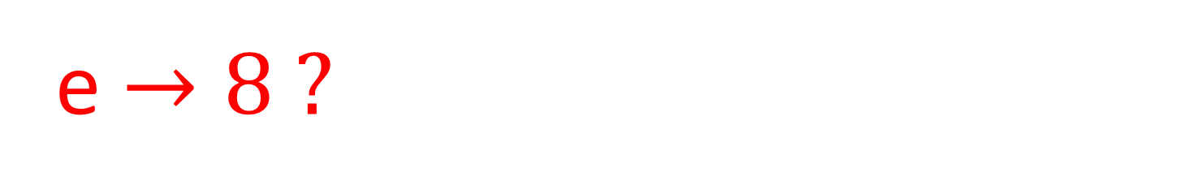
Information Entropy
Shannon entropy
$P_{B_{i}}$ = $\frac{F_{i}}{totalbytes}$
$F_{i} ↔ number of instances$ of byte value $i$ in the file
e $→8 ?$
Yes: Encrypted No: Not encrypted

Slide 9
Normal
or
Abnormal
Conscious
or
Unconscious

Slide 12
Foreground Analysis
Package name
of encryption process
?
?
Y: Conscious
N: Unconscious
Foreground Application

Slide 14
ransomware can masquerade ?
Foreground Analysis Ineffective !

Slide 16
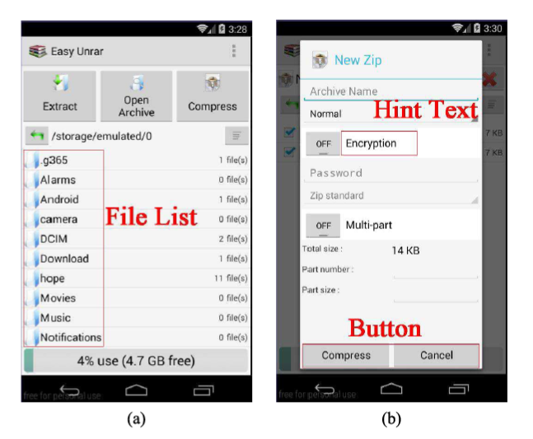
Benign app

Slide 18
Object Identifying
Clicking screen?
Activity switching?
Y
Y
N
N

Slide 19
LIGHTWEIGHT !!!
Exclusion
Same Activities
Input Method Editor

Slide 20
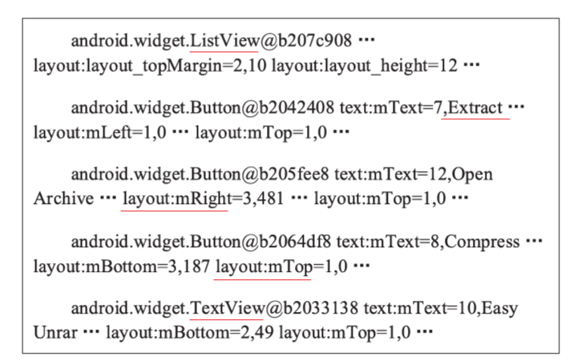
record

Slide 21
How to Detect Hint Text ?

Slide 22
NLP
Classifier
Regular Expression Matching
✓

Slide 23
Regular Expression Matching
Compute similarity
between extracted attributes
and predefined database

Slide 26
Coordinate Matching
Compute absolute coordinates (based on their parents containers)
Compare positions between click point and button scope
Button text justifying (similar to hint text indicator)

Slide 28
Evaluation

Slide 29
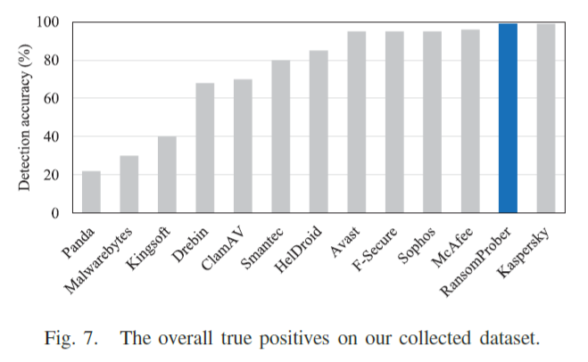

Slide 30
9 false positive samples!
4: hint text or button displayed by pictures
5: can encrypt but ignored
user-interaction

Slide 31
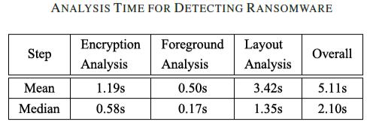

Slide 32
limitations
They assume that ransomware does not elevate privileges
→Need to cooperate with other malware scanners
Still can not avoid some file losses or encryptions

Slide 33
Other works

Slide 34
A Novel Structural-Entropy-based Classification Technique for Supporting Android Ransomware Detection and Analysis
2018 FUZZ

Slide 35
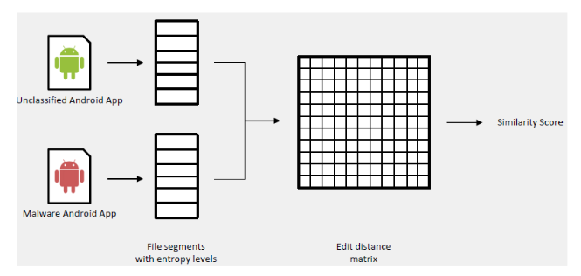
DiscernibilityClassifier | FURIA | FuzzyNN | FuzzyOwnershipNN
FuzzyRoughNN | NN | OWANN | VQNN

Slide 36
limitations
Best true positive rate: 0.841
Limited novelty

Slide 37
Hail to the Thief: Protecting Data from Mobile
Ransomware with ransomSafeDroid
2017 NCA

Slide 38
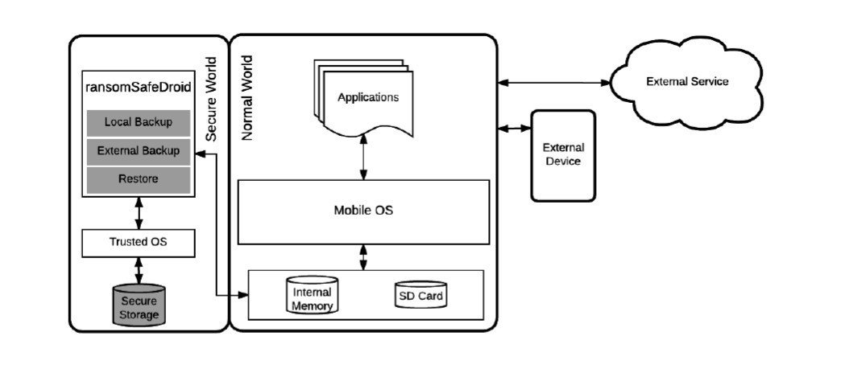

Slide 39
limitations
Only focusing on Backup
Limited novelty (heavily rely on ARM TrustZone)

